Slide 1



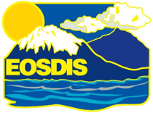
Data Workflow for Synthesis, Analysis, and Publication
Elizabeth Hoy & Peter Griffith
NASA Carbon Cycle & Ecosystems Office
Goddard Space Flight Center
Alison Boyer, Debjani Deb, & Suresh Vannan
ORNL Distributed Active Archive Center
Oak Ridge National Laboratory
January 24, 2018

Slide 2
Outline
ORNL DAAC
Update on ABoVE data publication
Data Flow
Benefits of data sharing
ABoVE Data Life Cycle
ABoVE Project Management Tools
How to publish your data at ORNL DAAC
How to search for and find ABoVE data
Conclusion & Discussion

Slide 3
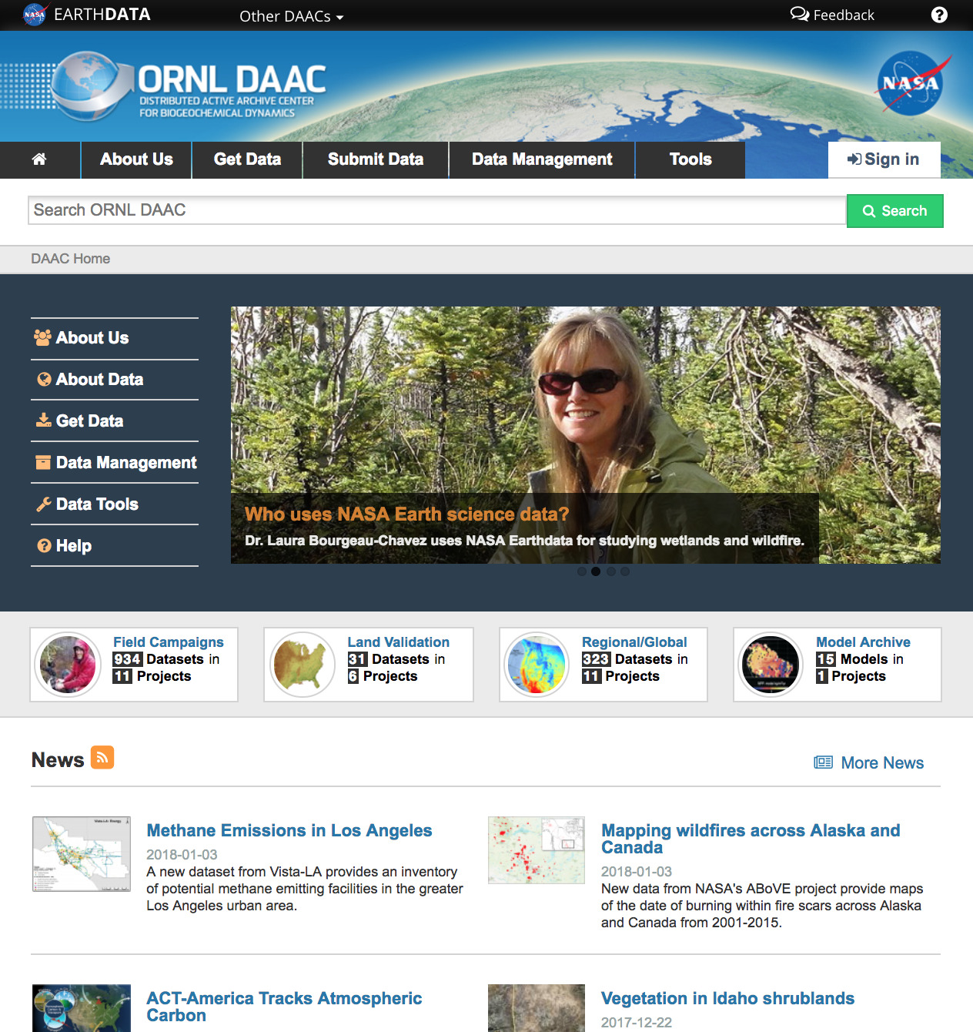
About ORNL DAAC
The Oak Ridge National Laboratory Distributed Active Archive Center (ORNL DAAC) archives data produced by NASA’s Terrestrial Ecology Program in support of the Carbon Cycle and Ecosystems Focus Area.
ORNL DAAC
Airborne
Land Validation
Regional and Global
Field Campaign
https://daac.ornl.gov
Notes:
The ORNL DAAC is the designated archive for all ABoVE data products.

Slide 4


ABoVE data flow
Primary archive (e.g. ASF, NSIDC DAAC)
Airborne data
ABoVE data portal
Field data
Public & External Partners
Model data
(e.g. NGEE-A,
Canadian partners,
Data.gov)
ABoVE Science Cloud
The ORNL DAAC provides a centralized mechanism to coordinate data sharing among ABoVE teams, the ABoVE Science Cloud, and to external partners (see data portal at https://search.earthdata.nasa.gov/portal/above/search ).

Slide 5
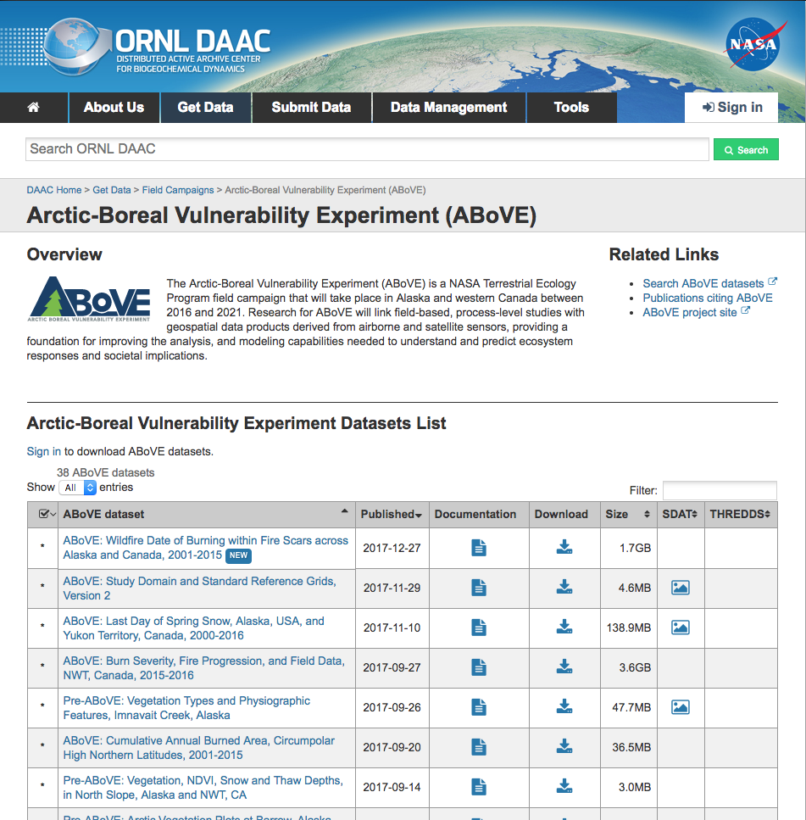
ABoVE data published by ORNL DAAC
38 ABoVE datasets are online
722+ GB of data delivered to 1149+ unique users
Data should be submitted to the ORNL DAAC as soon as “as soon as feasible but no later than 12 months after acquisition”.
Note: Data can be revised (V2, etc.) after initial release.
Refer to the ABoVE data policy: https://above.nasa.gov/implementation_plan/data_policy.html
Notes:
“Full, open, and timely sharing of the full suite of data sets for all ABoVE science team members is a fundamental objective”

Slide 6
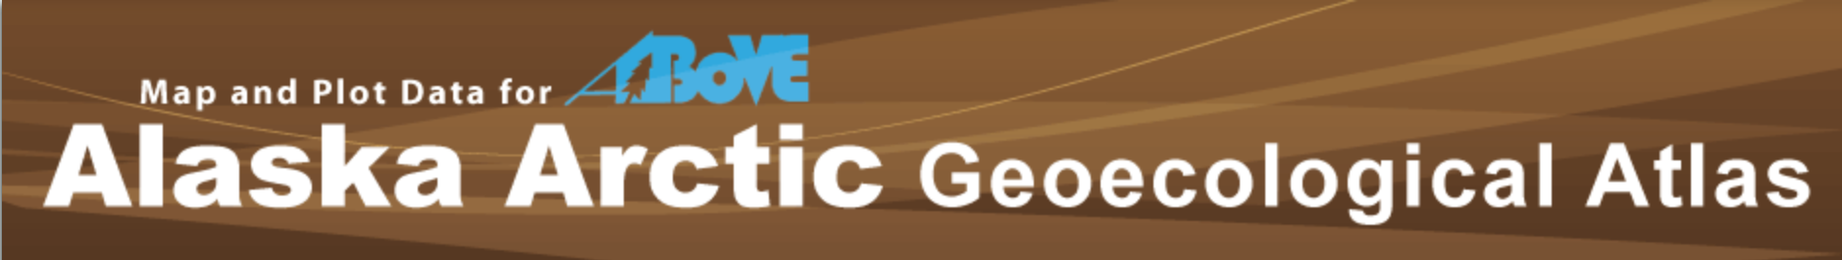
Recently-published data
ABoVE: Last Day of Spring Snow, Alaska, USA, and Yukon Territory, Canada, 2000-2016 (David Verbyla, UAF)
ABoVE: Burn Severity, Fire Progression, and Field Data, NWT, Canada, 2015-2016 (led by Laura Bourgeau-Chavez)
ABoVE: Cumulative Annual Burned Area, Circumpolar High Northern Latitudes, 2001-2015 (led by Tatiana Loboda)
Vegetation plot data from the Skip Walker Group at UAF (14+ datasets) from http://geobotanical.portal.gina.alaska.edu
In progress: AVIRIS-NG imagery from summer flights!
Browse ABoVE data at the ORNL DAAC: https://daac.ornl.gov/cgi-bin/dataset_lister.pl?p=34

Slide 7
Hot Dataset
Notes:
Most Downloaded

Slide 8
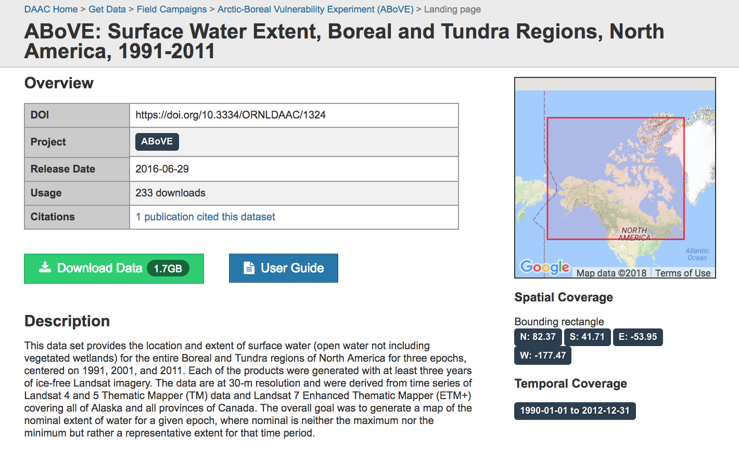
Hot Dataset → 233 downloads so far!
Carroll, M.L., M.R. Wooten, C. Dimiceli, R.A. Sohlberg, and J.R.G. Townshend. 2016. ABoVE: Surface Water Extent, Boreal and Tundra Regions, North America, 1991-2011. ORNL DAAC, Oak Ridge, Tennessee, USA. https://doi.org/10.3334/ORNLDAAC/1324

Slide 9
Gold Star Dataset

Slide 10
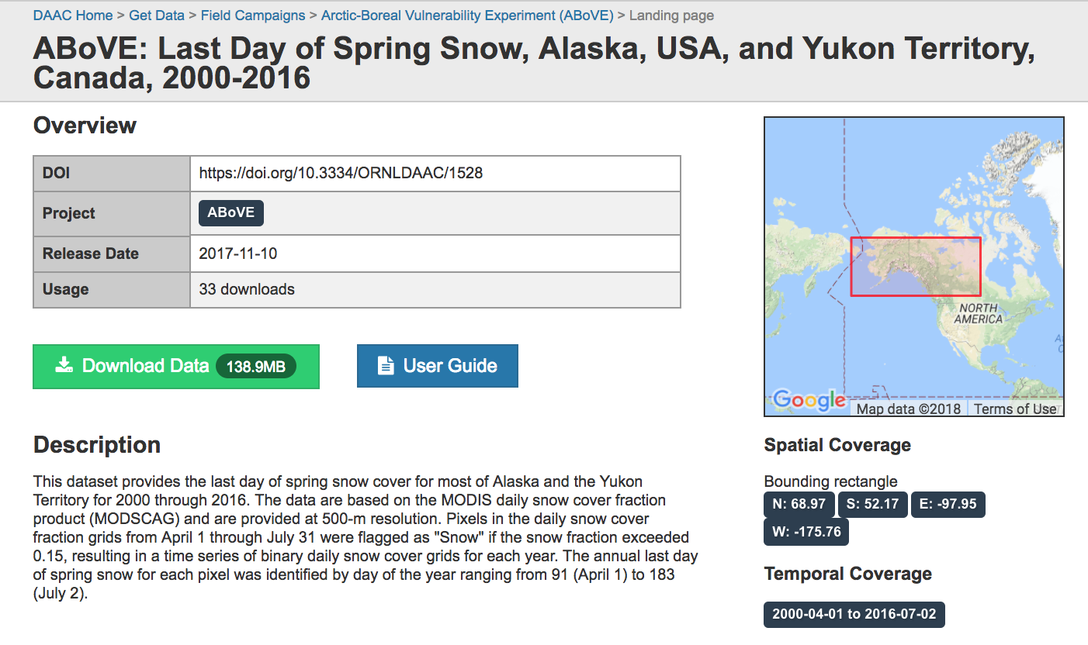
Gold Star Dataset
Verbyla, D. 2017. ABoVE: Last Day of Spring Snow, Alaska, USA, and Yukon Territory, Canada, 2000-2016. ORNL DAAC, Oak Ridge, Tennessee, USA. https://doi.org/10.3334/ORNLDAAC/1528

Slide 11
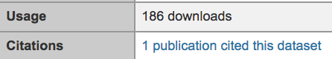
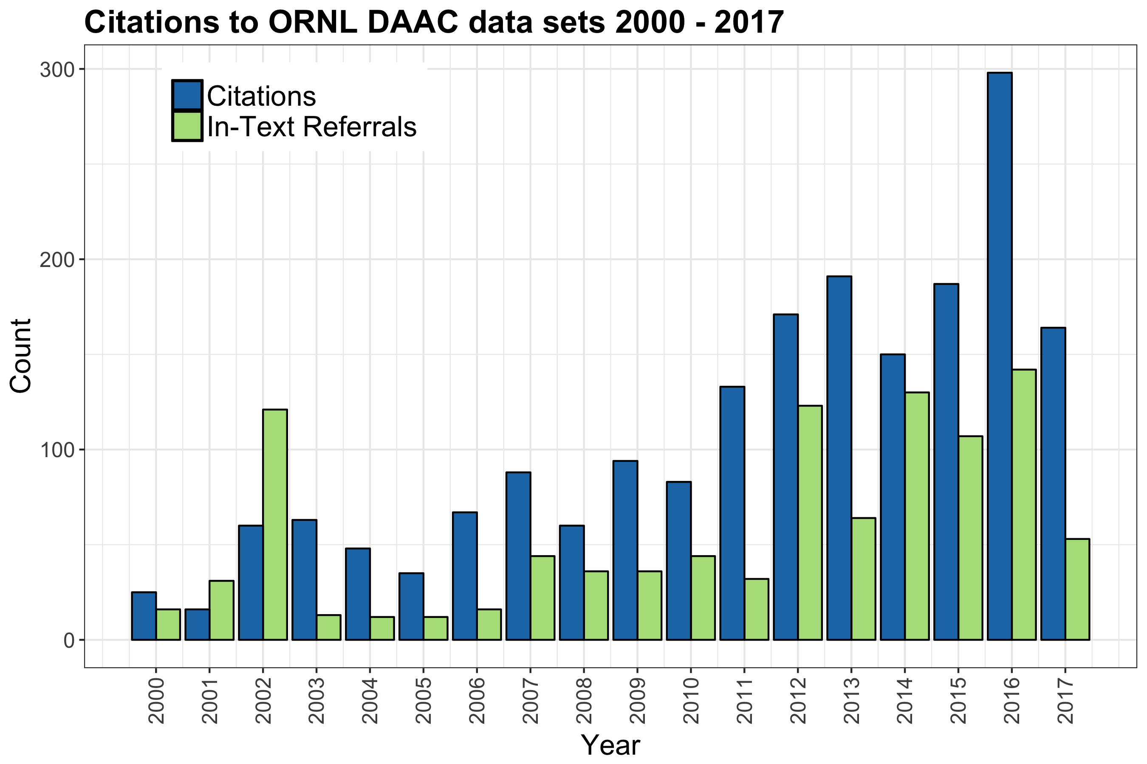
Benefits of Publishing Data
Get credit for your effort
Data citation
Digital Object Identifier (DOI)
Measure impact of data
Citation statistics
Download statistics

Slide 12
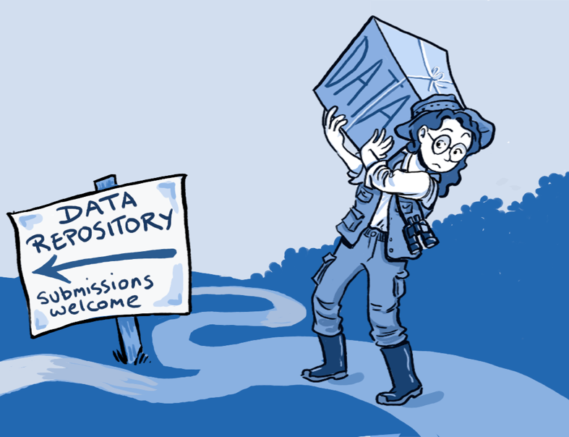
Benefits of Publishing Data
Get credit for your effort
Data citation
Digital Object Identifier (DOI)
Measure impact of data
Citation statistics
Download statistics
Contribute to synthesis activities
Leverage DAAC curation and data services
Visualize
Subset
Access through webservice
Increase access to Federally funded scientific research
By Roche DG et al. (2014) Troubleshooting Public Data Archiving: Suggestions to Increase Participation. PLoS Biol 12(1): e1001779. doi:10.1371/journal.pbio.1001779

Slide 13
Data Life Cycle for ABoVE
CCE Office
NASA HQ
Science Team
Implementation Plan
Calls for Proposals
Plan
Selection of Funded Proposals/Scientists
Identify Communities of Practice
CF Metadata, Ameriflux, GTN-P
Analyze
Collect
Funded Scientists
CCE Office
SensorML, Instrument Vendors, SmartPhone Apps
Other Data
Integrate
QA/QC
Model and Observational Data
Windows: ESRI Linux: R, Python, IDL, Mathworks
Discover
Analyze
Traditional Project
Publish
Archive
Describe
Data Reuse
NASA DAACs
NSIDC
Closing the Data Life Cycle
Augmented from Rüegg et al 2014 in Front Ecol Environ

Slide 14
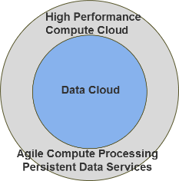
The ABoVE Science Cloud may be used throughout the data lifecycle
CCE Office
NASA HQ
Science Team
Implementation Plan
Calls for Proposals
Plan
Selection of Funded Proposals/Scientists
Identify Communities of Practice
CF Metadata, Ameriflux, GTN-P
Analyze
Collect
Funded Scientists
CCE Office
SensorML, Instrument Vendors, SmartPhone Apps
Other Data
Integrate
QA/QC
Model and Observational Data
Windows: ESRI Linux: R, Python, IDL, Mathworks
Discover
Analyze
Traditional Project
Publish
Archive
Describe
Data Reuse
NASA DAACs
NSIDC
Closing the Data Life Cycle
Augmented from Rüegg et al 2014 in Front Ecol Environ
Notes:
Front Ecol Environ = Frontiers in Ecology and the Environment.
The practice of documenting and submitting datasets to data repositories is not new.
Talk about how to update this slide….

Slide 15



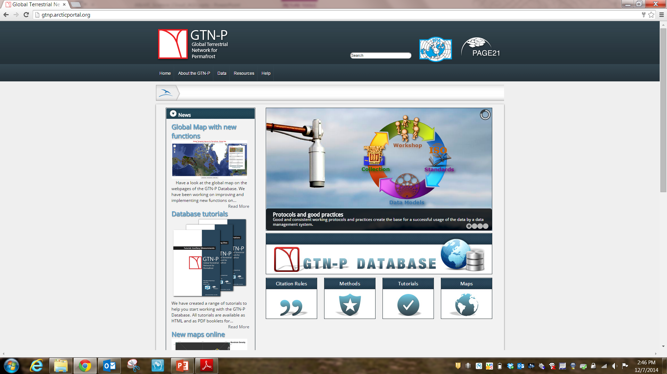

Long-tail data during ABoVE
Use existing communities of practice whenever possible
Develop new workflows as needed
Use ORNL DAAC best practices
ABoVE Grid and Projection
SAR ad-hoc working groups

Slide 16
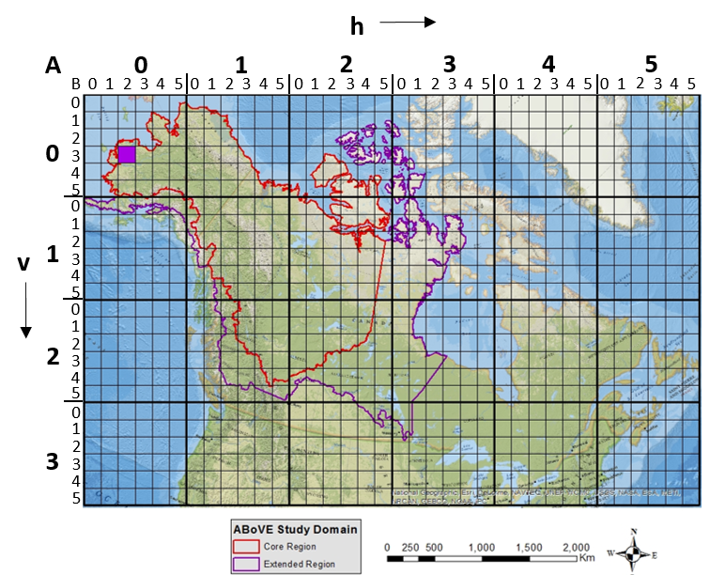
ABoVE Standards
ABoVE has developed a defined set of field locations and measurements
Defined locations
Measurement list
DAAC can help standardize variables, units, etc.
Study domain and grid (avail. from DAAC)
Projection: Albers Conical Equal Area
Refer to the ABoVE data policy: https://above.nasa.gov/implementation_plan/data_policy.html

Slide 17
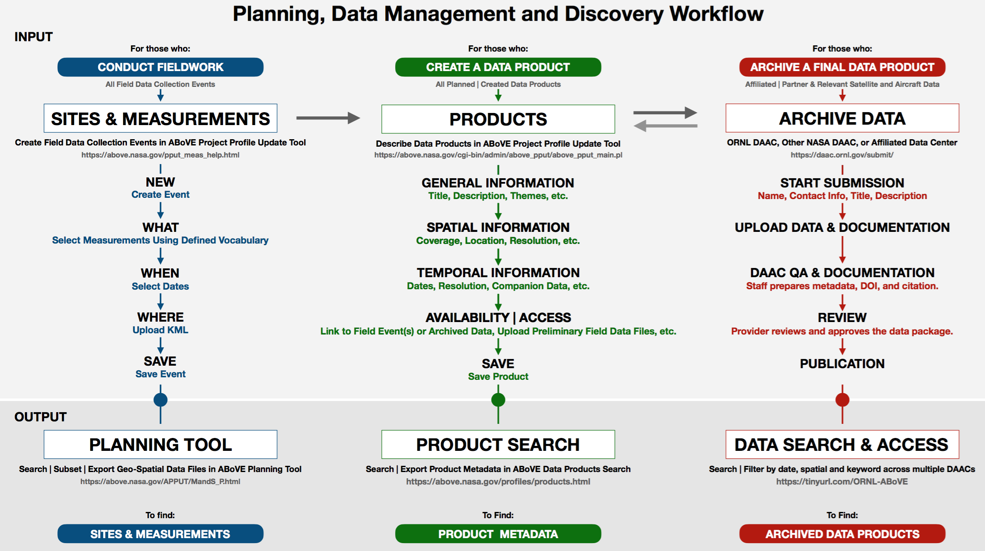

Slide 18
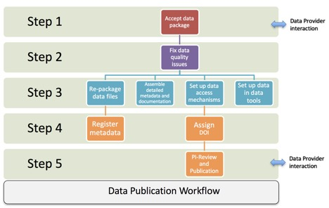
How to Publish Data with ORNL DAAC
Start your data submission: Submit Data. Upload data and supplemental files, including description documents and any associated papers.
Notes:
Start your data submission: Submit Data. Data inquiries will be reviewed and a decision will be sent to you by email within a few days.
Submit your data and documentation
You will receive an email from our data submission system with instructions on how to upload your data files and supplemental files, including description documents and any associated papers, to the ORNL DAAC system. You will also be asked to answer a few questions about the data (example questions).

Slide 19
How to Publish Data with ORNL DAAC
2. DAAC performs data quality review using our quality assurance checklist and writes documentation. We may contact you with questions.

Slide 20
How to Publish Data with ORNL DAAC
3. DAAC staff will prepare metadata and comprehensive documentation about your data. Spatial data may be added to our Spatial Data Access Tool, and NetCDF-format data may be added to our OPeNDAP data service.

Slide 21
How to Publish Data with ORNL DAAC
4. ORNL DAAC generates a citation and registers a DOI for the dataset.

Slide 22
How to Publish Data with ORNL DAAC
5. When the data and documentation are ready, you will be asked to review and approve the final data package before it is published. The DAAC will distribute metadata to the NASA EOSDIS clearinghouse and other relevant data catalogues. The ORNL DAAC also advertises the data online through email, social media, and the DAAC website.
Notes:
Overall timeframe is one month.

Slide 23
ABoVE data flow
Primary archive (e.g. ASF, NSIDC DAAC)
Airborne data
ABoVE data portal
Field data
Public & External Partners
Model data
(e.g. NGEE-A,
Canadian partners,
Data.gov)
ABoVE Science Cloud
The ORNL DAAC provides a centralized mechanism to coordinate data sharing among ABoVE teams, the ABoVE Science Cloud, and to external partners (see data portal at https://search.earthdata.nasa.gov/portal/above/search ).

Slide 24
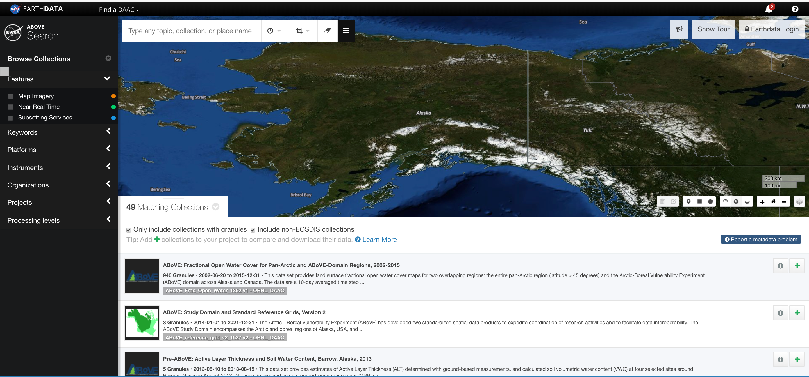
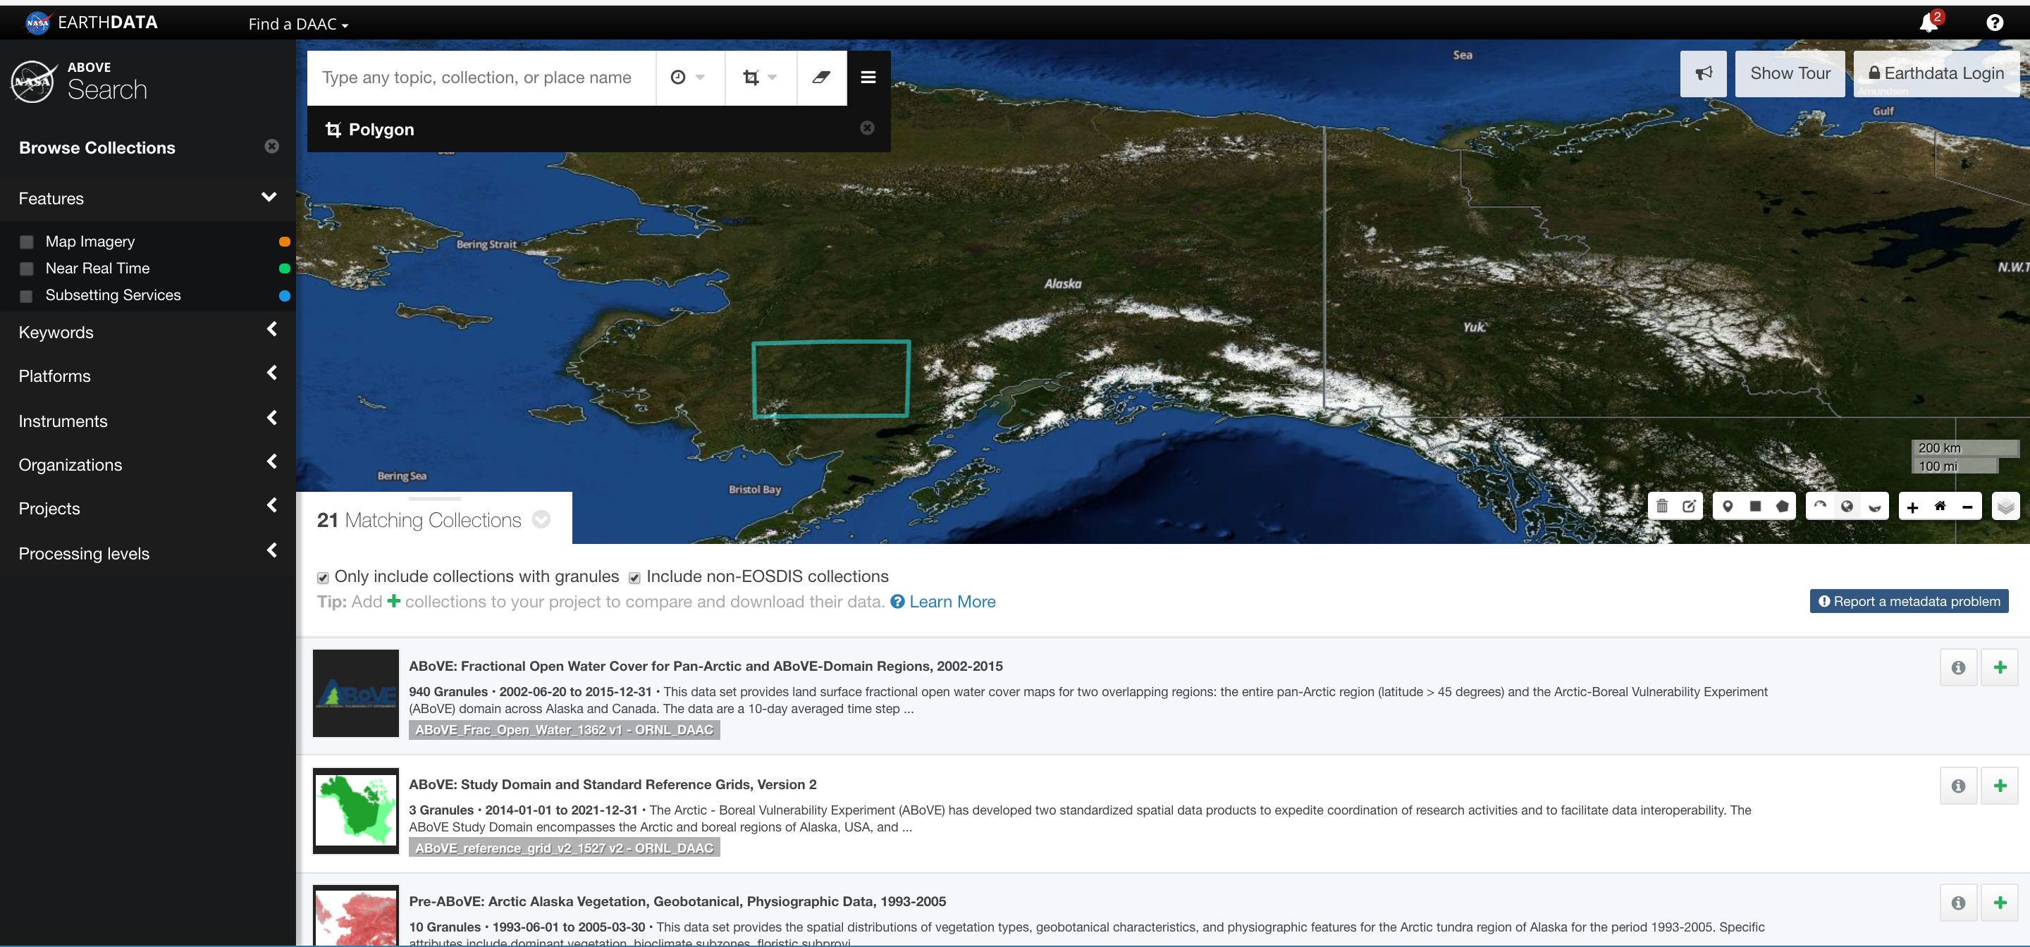
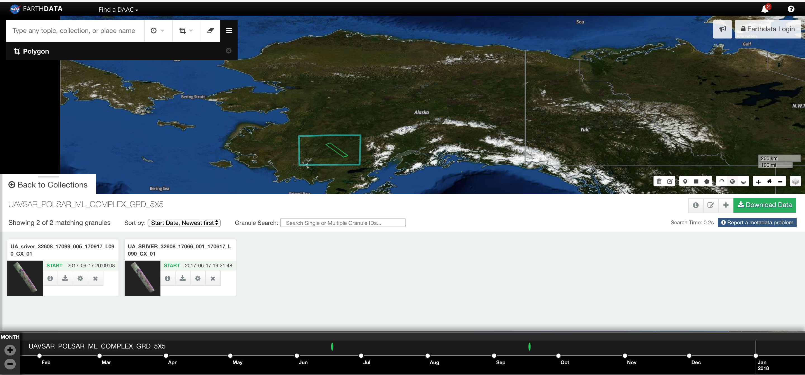
Searching for ABoVE datasets: https://search.earthdata.nasa.gov/portal/ABoVE/search
Select Individual Granules

Slide 25
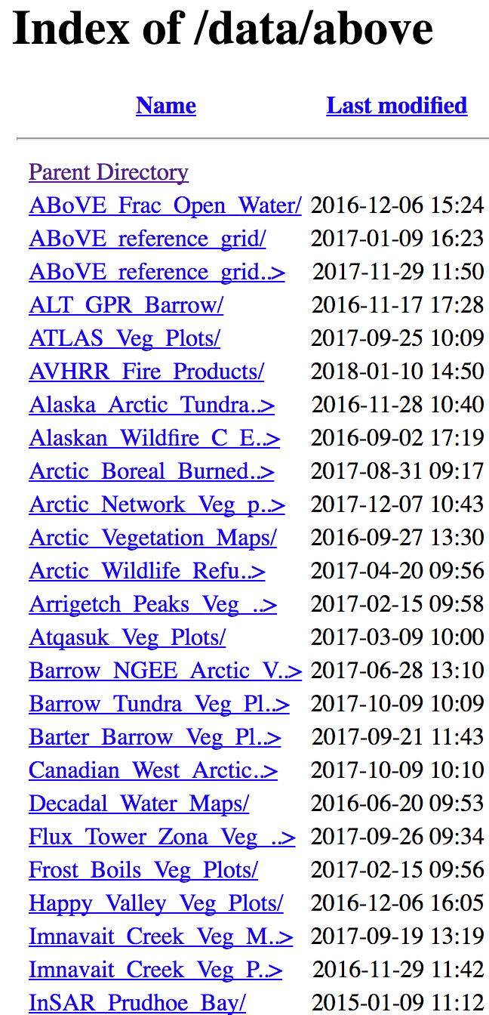
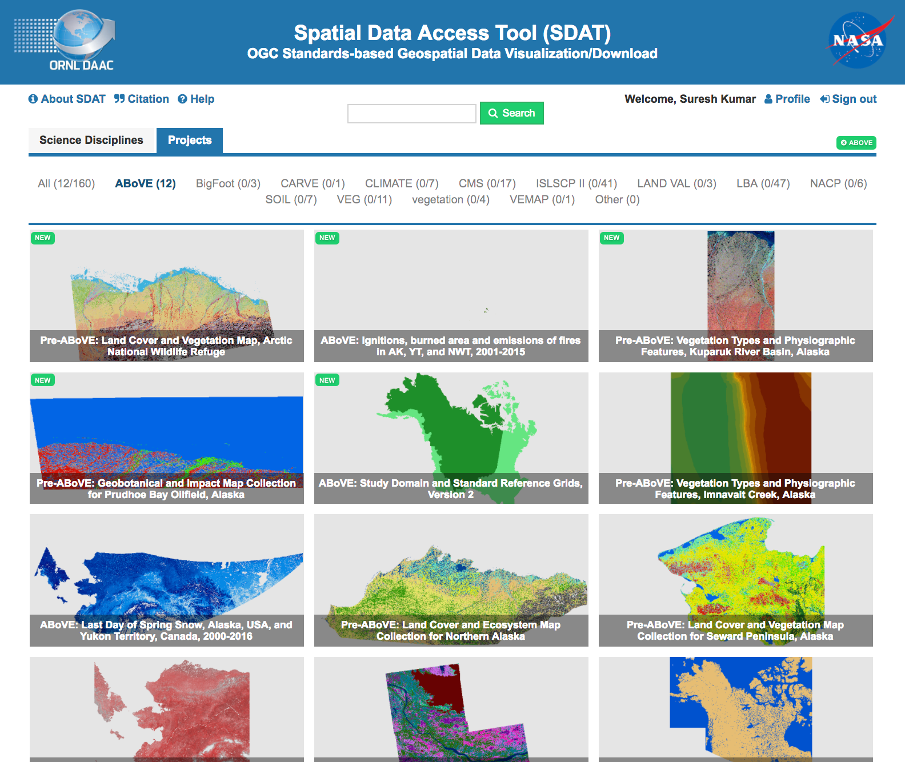
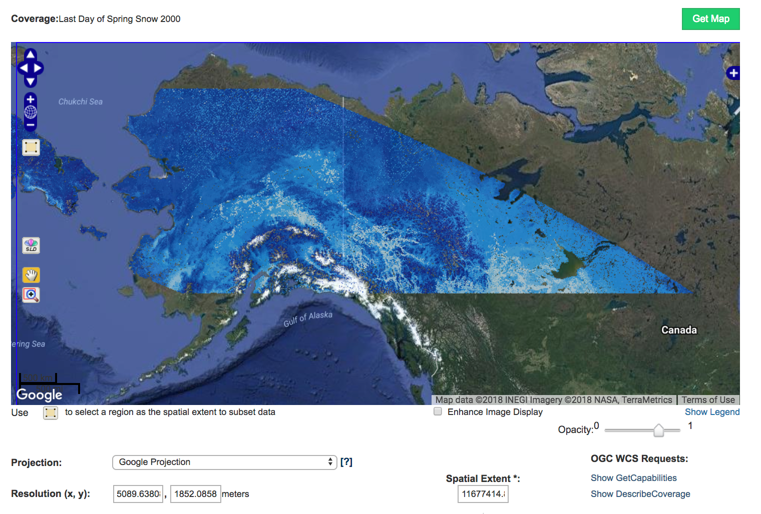
Data Services at ORNL DAAC
Data Pool
Spatial Data Services
https://daac.ornl.gov/data/above/
https://webmap.ornl.gov/wcsdown

Slide 26
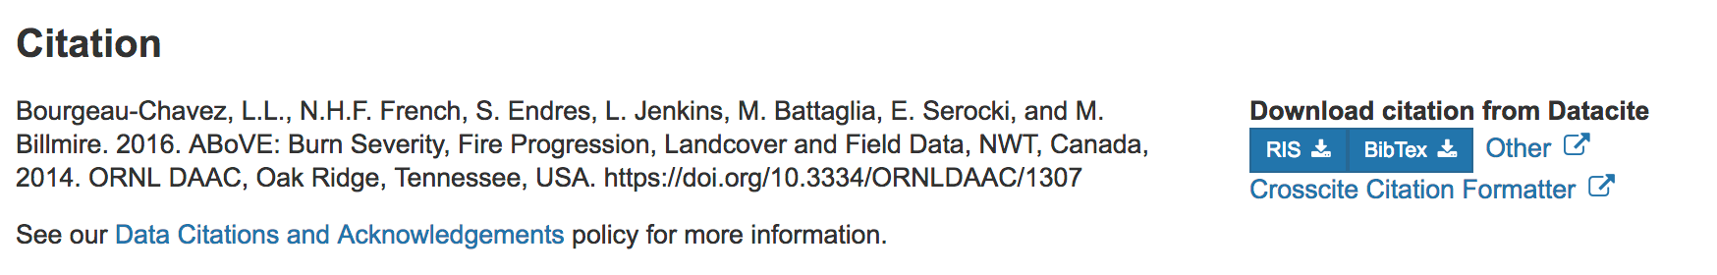
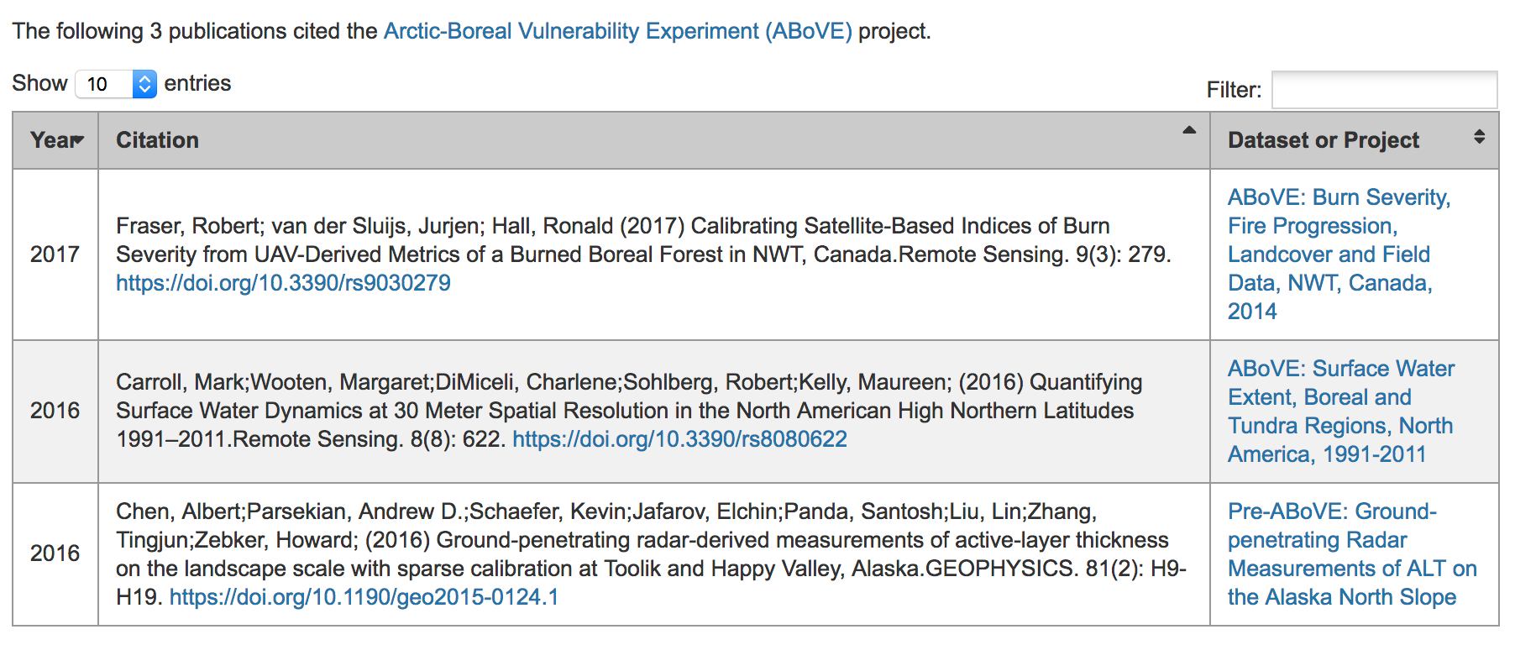
Citing Data

Slide 27


Questions?
DAAC serves as a clearinghouse for all ABoVE-related data
Submission Guidelines: https://daac.ornl.gov/PI/
Start your data submission: https://daac.ornl.gov/submit/
What can DAAC do to help?
Cross-listing Partner data (Canadian agencies, NGEE-Arctic)?
Data Management Best Practices: https://daac.ornl.gov/PI/
Email Alison: boyerag@ornl.gov
facebook.com/OakRidgeDAAC
@ORNLDAAC
Notes:
Alison 5 mins

Slide 28
Backup slides

Slide 29
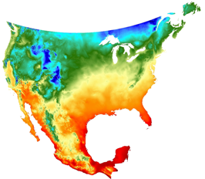
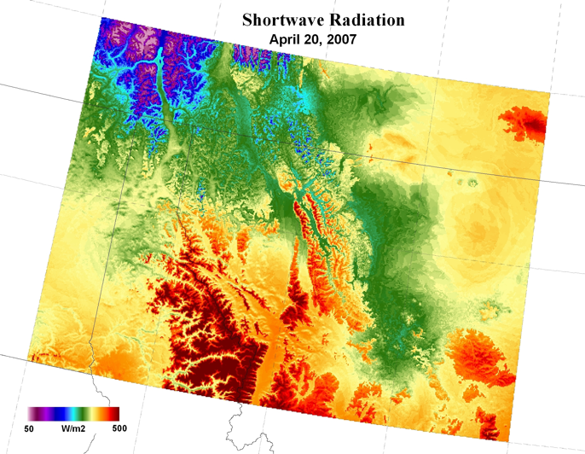
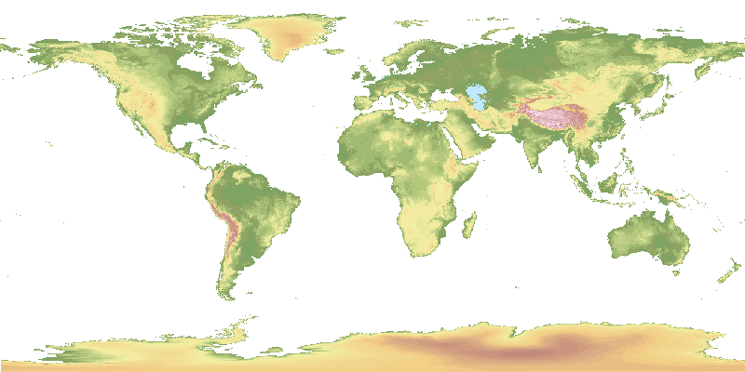
Suggested Geospatial File Formats
Raster formats
Geotiff
netCDF
with CF convention preferred
HDF
Vector
Shapefile
ASCII
Minimum Temperature
GTOPO30 Elevation
29

Slide 30
Ten principles of data management
Define the contents of your data files
Define the variables
Use consistent data organization
Use stable file formats
Assign descriptive file names
Preserve processing information
Perform basic quality assurance
Provide documentation
Protect your data
Preserve your data
Notes:
These are basic habits that will help improve the information content of your data and make it easier to share with others

Slide 31
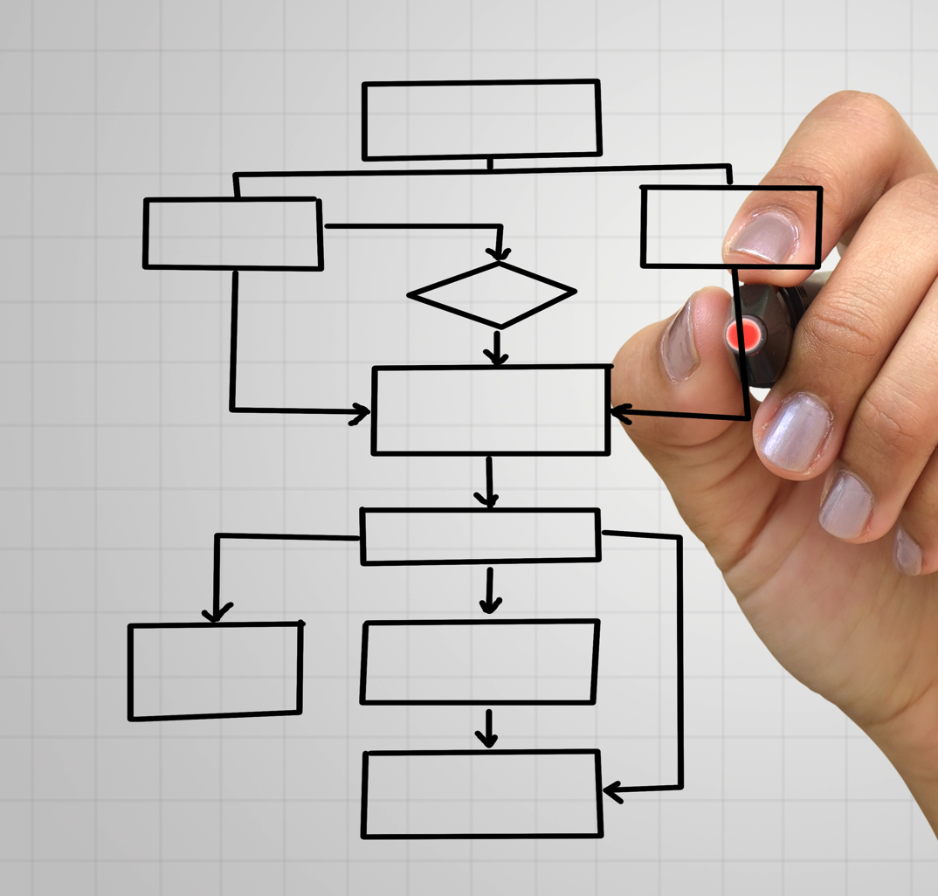
Data Management – Project level
Define data workflow – collection to archive
Communicate standards and metadata needs
Define data quality criteria
Document data and process regularly
Identify a data steward
Contact the DAAC early and often
Notes:
Suresh begin

Slide 32
Data stewardship at ORNL DAAC
Over the longer-term, the ORNL DAAC also:
Provides tools to explore, access, and extract data
Provides long-term, secure archiving (back-up and recovery)
Addresses user questions, and serves as a buffer between users and data contributors
Provides usage & download and data citation statistics
Provides value-added harmonization services for synthesis

Slide 33
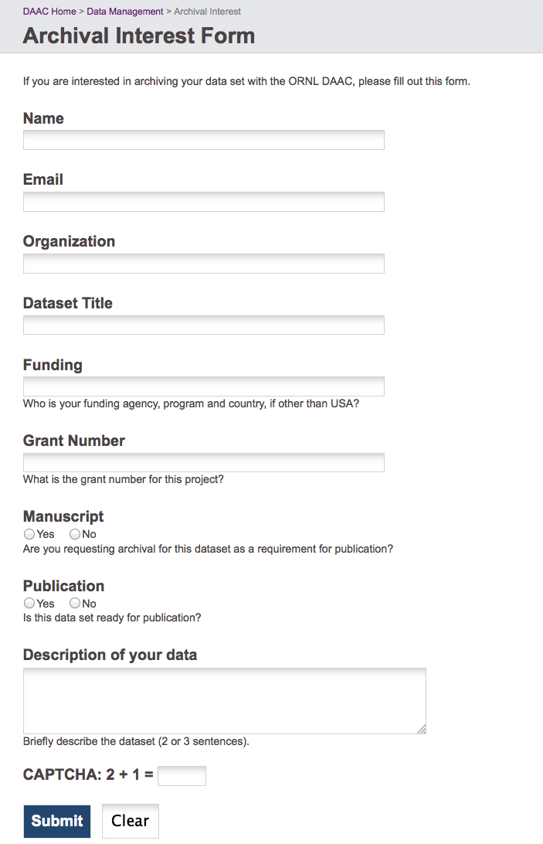


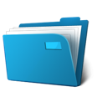

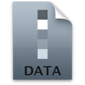
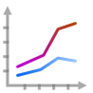
Submitting Data to ORNL DAAC
Step 1: Initiate Submission
http://daac.ornl.gov/archival_contact_form.html
Step 2: Submit Data
http://daac.ornl.gov/archival_contact_form.html
Step 3: Data Publication
Data Citation
Search Tools
Visualization
Web Services

Slide 34
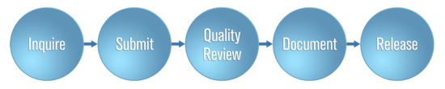

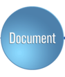

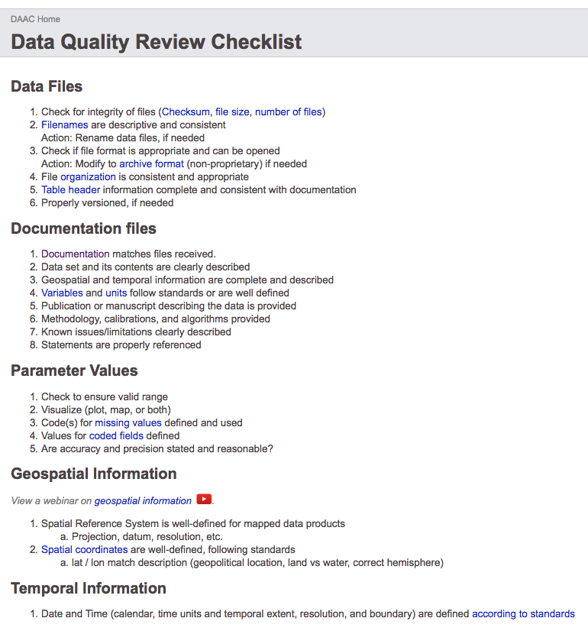
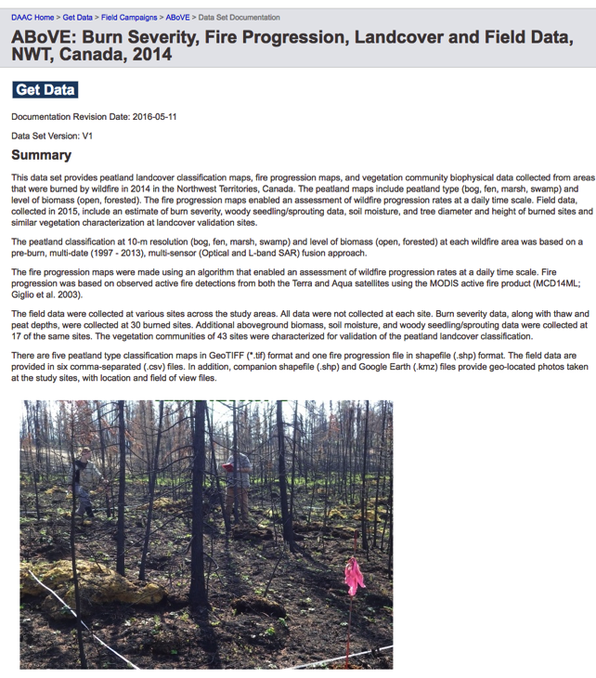
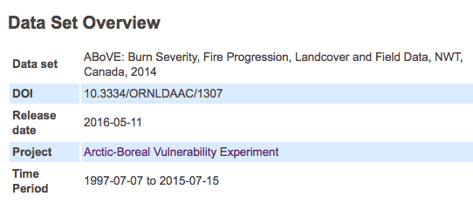
ORNL DAAC Curation Process
Notes:
Might consider telling participants what criterion are examined to determine whether data is accepted to ORNL DAAC or not. Does the data remain property of investigator? Or does the data become ORNL DAAC data?

